Slide 1


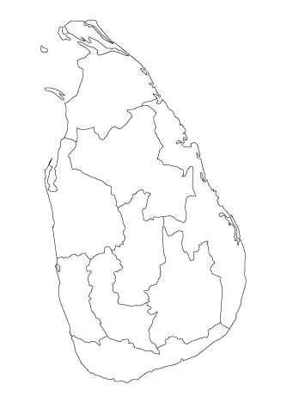
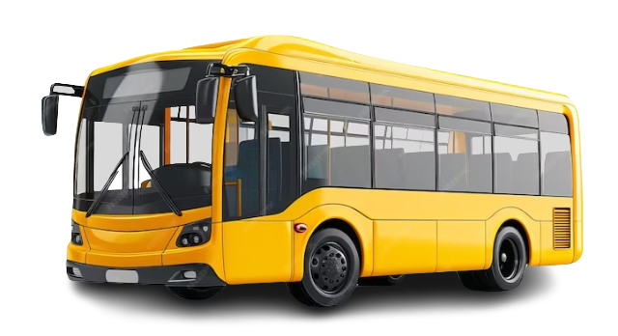

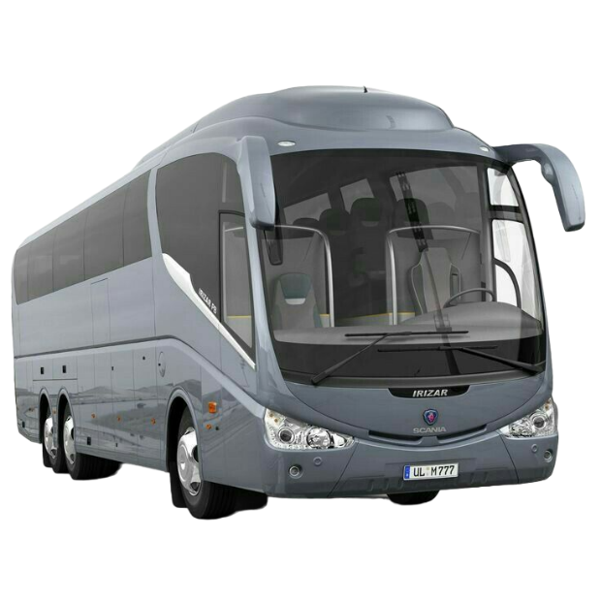
Sri Lanka Intelligent Bus Navigation and Passenger Information System
24-25J-237

Slide 2




Team Members
Senarathne A.S.A.G
IT21205460
(Leader)
Kalhara N.V.
IT21202490
Rajapaksha R.L.H.P.
IT21192050
Thanusan M.
IT21175848

Slide 3


Buses are the main mode of public transportation (CTB or private) in Sri Lanka.
Buses often do not run on time, leading to wasted time for passengers and missed buses.
Public transportation in Sri Lanka often fails to provide passengers with a comfortable journey to their destinations.
Due to the competitive nature of the business, many bus accidents occur each year in public transport. As a result, a significant number of lives are lost in the country.
When tourists visit Sri Lanka, they have difficulty finding the bus they need due to language barriers and other challenges.

Slide 4

Research Problem
Provide passengers with accurate information about the crowd level on the bus they plan to board, ensuring they can find their desired bus at the correct stop and receive reliable arrival times.
How to Minimize competition between buses to improve service efficiency and safety, reducing the likelihood of accidents and ensuring a better experience for all passengers.
How to Assist visually impaired passengers in easily locating the bus they need, while also helping tourists overcome language barriers to find the correct buses.
How to Implement a cashless bus fare payment system to simplify transactions for passengers and streamline the boarding process.
How to Provide alerts to passengers about important upcoming stations.

Slide 5

Research Objectives
Main objective - Ensuring passengers reach their destination comfortably and avoid missing buses.

Slide 6
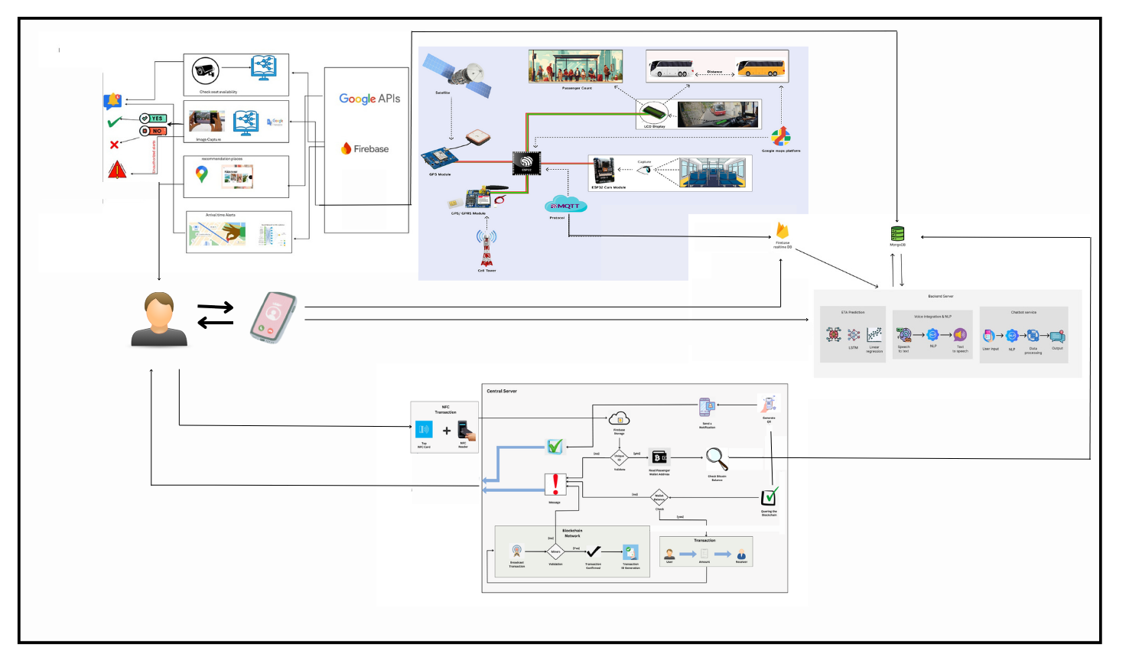
Overall System Diagram

Slide 7

IT21205460 |SENARATHNE A.S.C.G
BSc (Hons) Degree in Information Technology ( specialization in Information Technology )

Slide 8
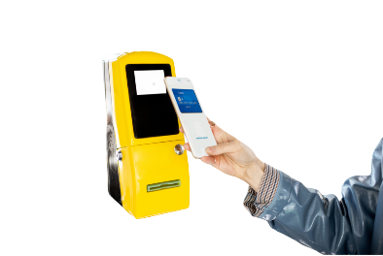
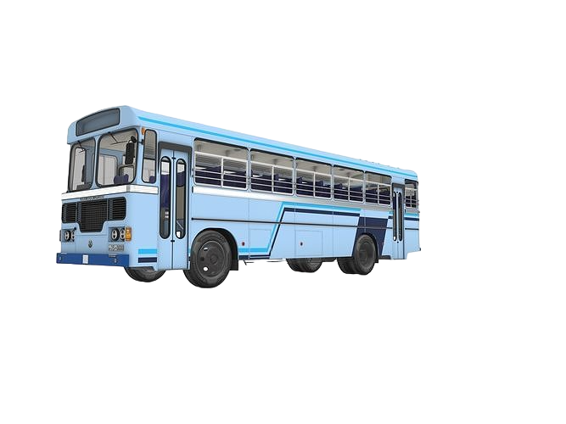
BACKGROUND
Sri Lanka's public transportation, especially bus ticketing, is inefficient, prone to errors, and inconvenient.
Enables quick, contactless transactions, improving user experience for passengers.
Provides secure, transparent transaction recording, reducing fraud risk and enhancing trust.
Combine NFC and blockchain [1] to enhance ticketing efficiency, security, and reliability.
Upon NFC card tap, the transaction is processed on the blockchain, and the conductor receives immediate confirmation.
Potential to implement loyalty programs and passenger categorization to further improve public transportation.
IT21205460 | Senarathne A.S.C.G. | 24-25J-237

Slide 9



An Approach of Enhancing the Quality
of Public Transportation Service in Sri
Lanka using IoT [2]
NFC Based Smart Urban Public Bus
Transport Payment System [3]
A microtransaction model based on
blockchain technology to improve
service levels in public
transport sector in Sri Lanka [4]
Comparison Chart
Application Reference | Use Blockchain Technology | Use NFC Cards | Reward System | Passengers Categorization
Research A
Research B
Research C
Proposed System
IT21205460 | Senarathne A.S.C.G. | 24-25J-237

Slide 10



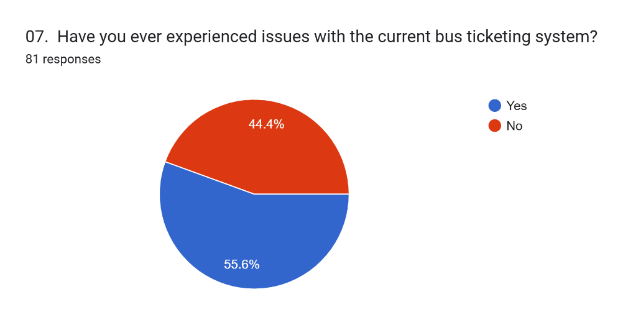

What is the best way to ensure conductors receive real-time transaction confirmations?
IT21205460 | Senarathne A.S.C.G. | 24-25J-237

Slide 11

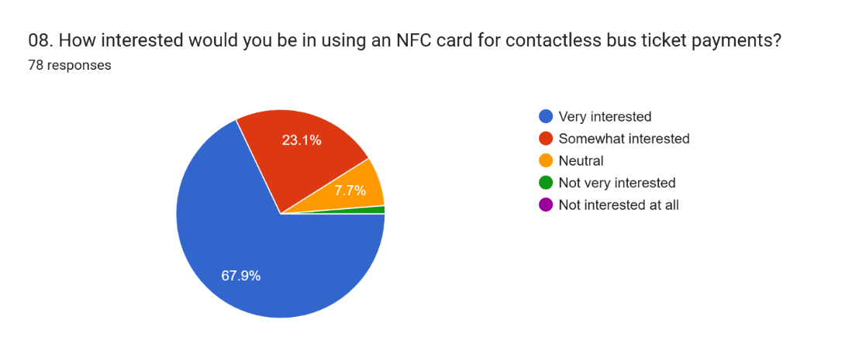
How can NFC and blockchain be combined for efficient and secure bus ticket purchases in Sri Lanka?
IT21205460 | Senarathne A.S.C.G. | 24-25J-237

Slide 12


Specific Objective and Sub Objectives
Implementing blockchain for secure, transparent transactions.
Implementing blockchain for secure, transparent transactions.
Categorization of the passengers and Requesting NFC cards.
Enhancing public transportation efficiency in Sri Lanka through advanced payment technologies.
Enabling quick payments via NFC card taps.
Ensuring prompt transaction communication with the conductor.
IT21205460 | Senarathne A.S.C.G. | 24-25J-237

Slide 13


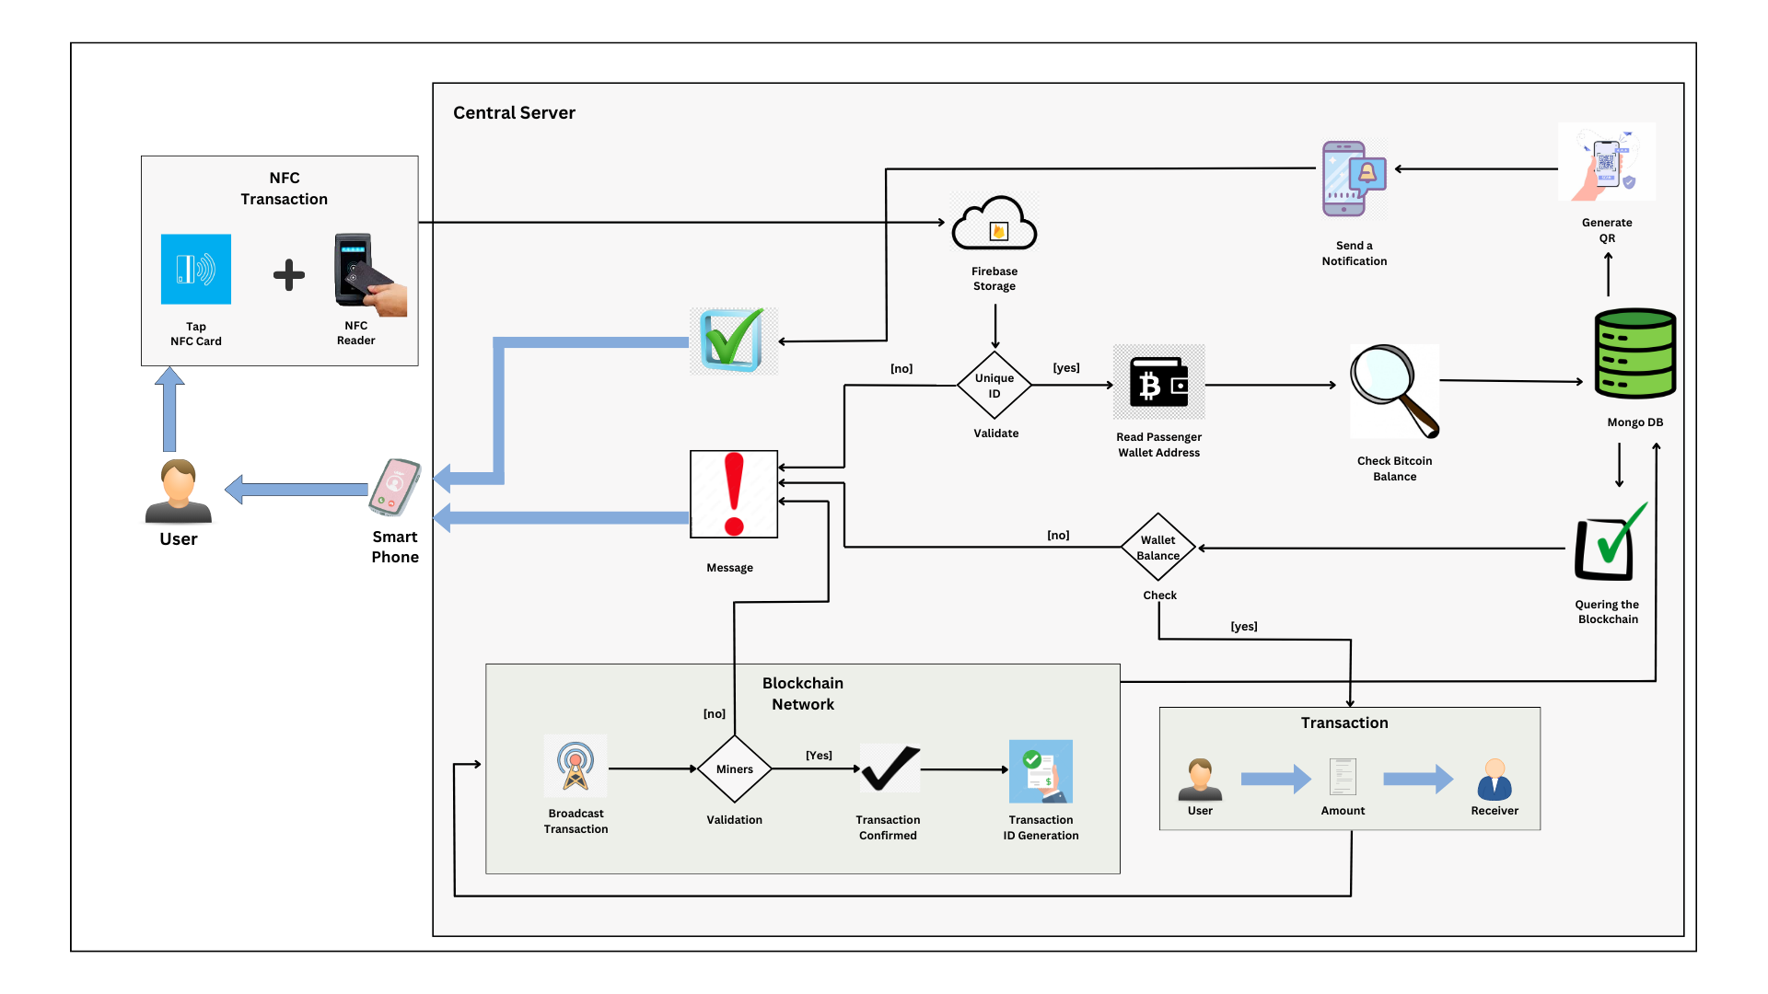
IT21205460 | Senarathne A.S.C.G. | 24-25J-237

Slide 14
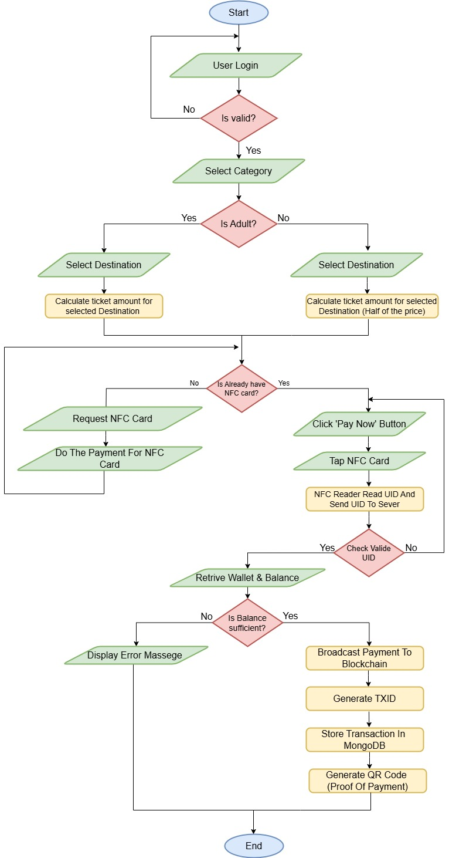
FLOW CHART
OVERALL COMPONENT
IT21205460 | Senarathne A.S.C.G. | 24-25J-237

Slide 15



Technologies to be used
Algorithms and
Architecture
Two factors authentication
Technologies
Django
React native
NFC
Blockchain
MongoDB
Firebase
Techniques
JWT (JSON Web Tokens)
IT21205460 | Senarathne A.S.C.G. | 24-25J-237

Slide 16
PROJECT REQUIREMENTS
Software Requirements
Django
React native
NFC
Blockchain
MongoDB
Firebase.
Personnel Requirements
Specializing in Django and blockchain integration.
Skilled in React Native for mobile app development.
Responsible for designing the overall architecture, including NFC and blockchain integration.
Ensures system security, especially for blockchain and data encryption.
Overseeing project timelines and component integration.
Functional Requirements
Implement blockchain for secure and transparent transactions.
Enable quick and easy payments via NFC card taps.
Ensure real-time communication of transaction details to the driver.
Store user profiles, transactions, and loyalty program data securely.
Non-Functional Requirements
Design an intuitive and easy-to-use interface.
Ensure the application works seamlessly on both Android and iOS.
The system should handle many users and transactions efficiently.
Ensure the system is always reliable and available.
Implement robust security measures to protect data and transactions.
IT21205460 | Senarathne A.S.C.G. | 24-25J-237

Slide 17




Completed Sub – Objectives
Sub – Objective – 1
Implementing blockchain for secure, transparent transactions.
Sub – Objective – 2
Categorization of the passengers and Requesting NFC cards.
Evidence of Completion
Authenticating Users
Categorizing Passengers
Calculating cards (Route Tickets) Prices
Requesting NFC Cards
IT21205460 | Senarathne A.S.C.G. | 24-25J-237

Slide 18
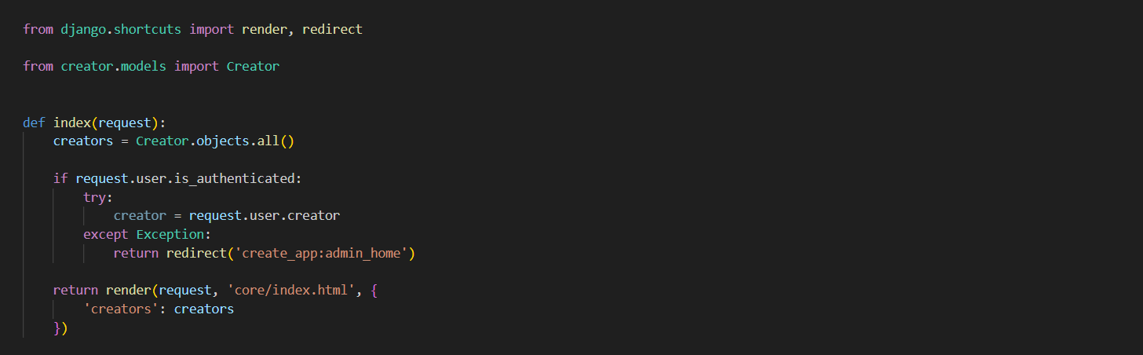
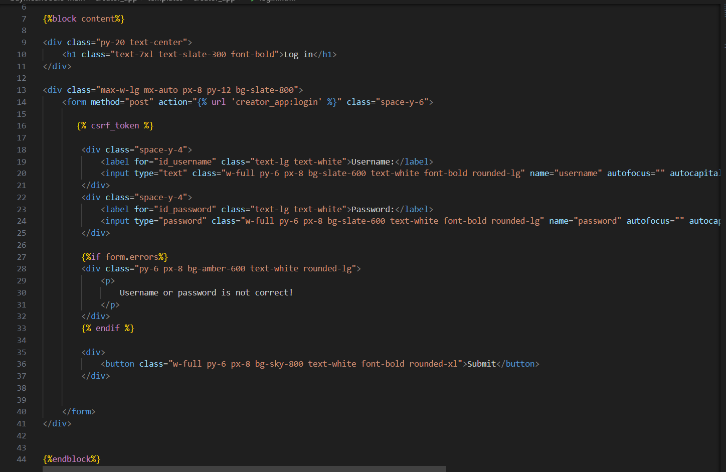
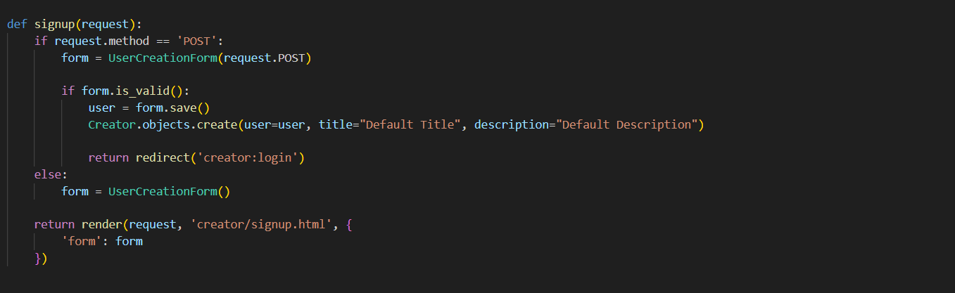
Sub Objective - 1
Authenticating
Login API
Login html tags
Signup API

Slide 19

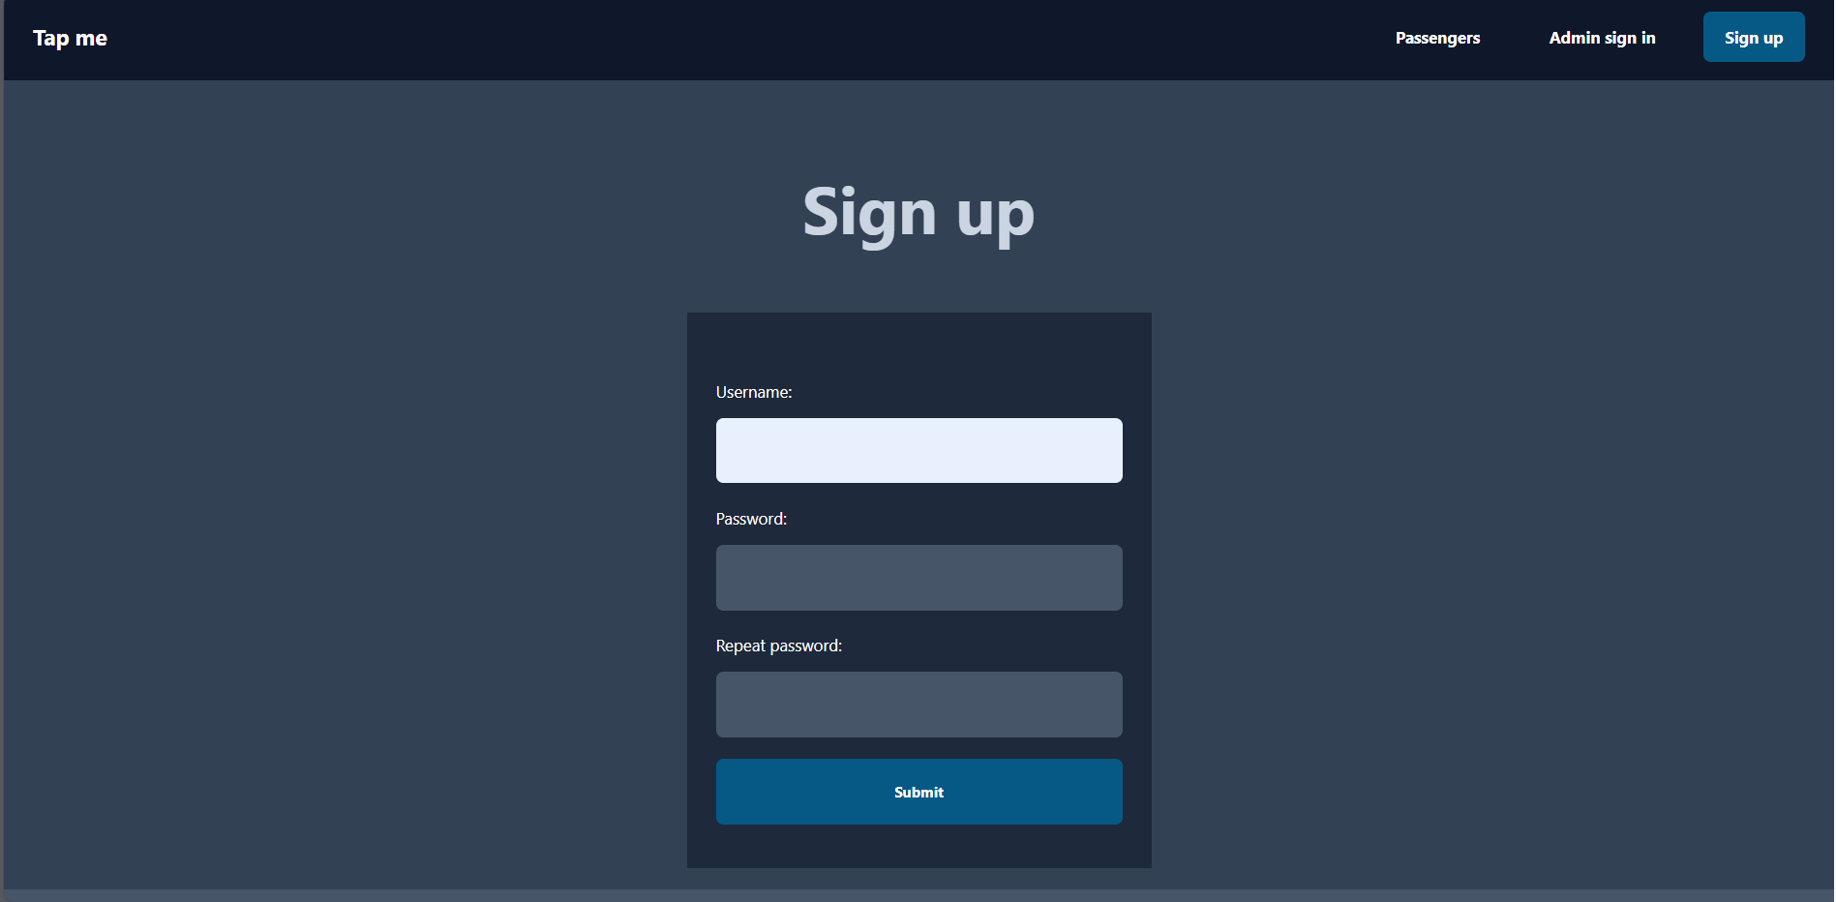

Sub Objective - 1
Authenticating
Login Sample Interface
Signup Sample Interface

Slide 20



Sub Objective - 2
Select the best Payment Gateway
Cryptomus
Coinbase
Why not Cryptomus?
Less Widely Recognized
Decent, but not Widely
Recognized
Growing, but not as popular
Why Coinbase?
Well – established, widely
trusted globally
High – level Security with
insurance & 2FA
Large user base, widely used
in industries

Slide 21
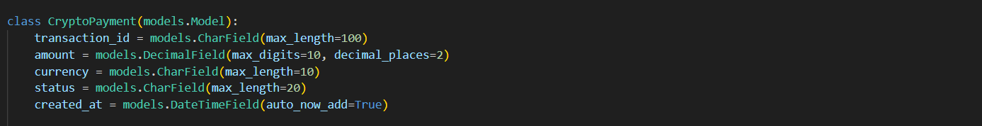
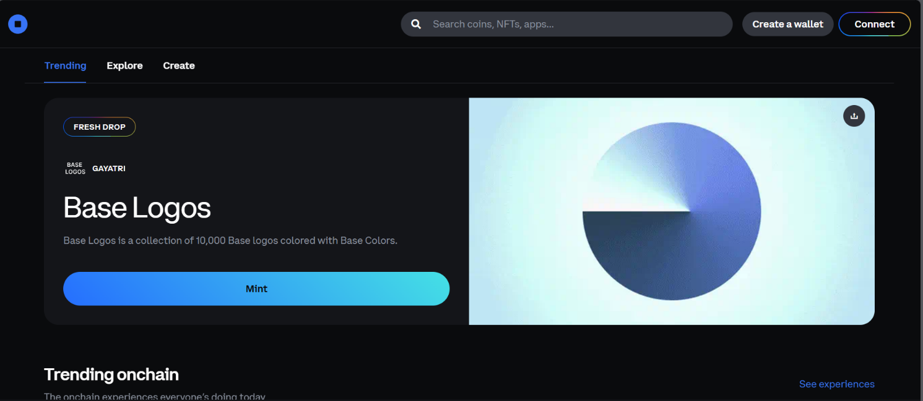
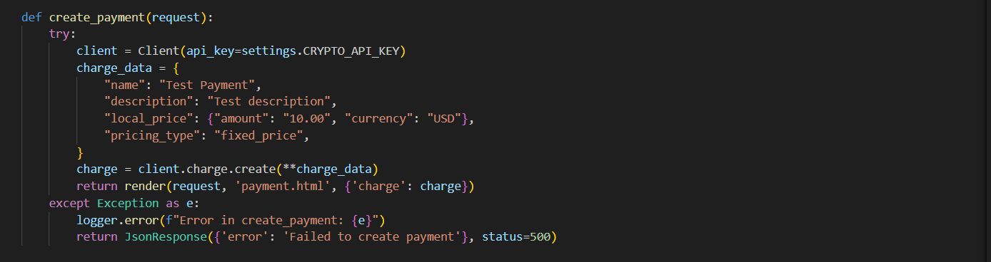
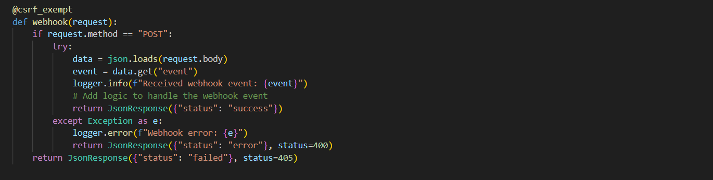
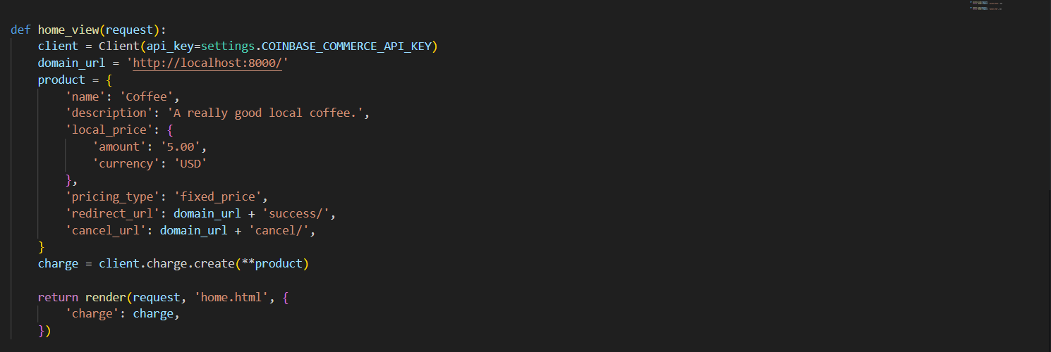
Sub Objective - 2
Payment
Payment Model
Payment Gateway API key Initialization
Coinbase Payment Gateway interface
Payment API
Webhook API
Payment Home API

Slide 22
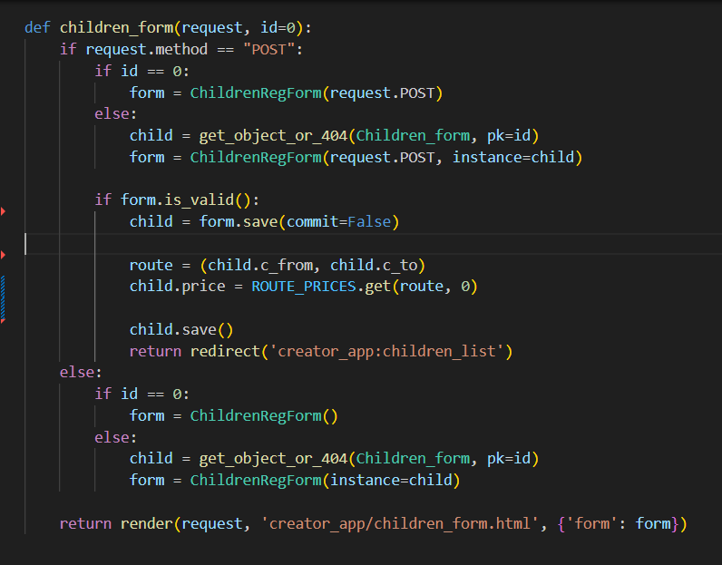
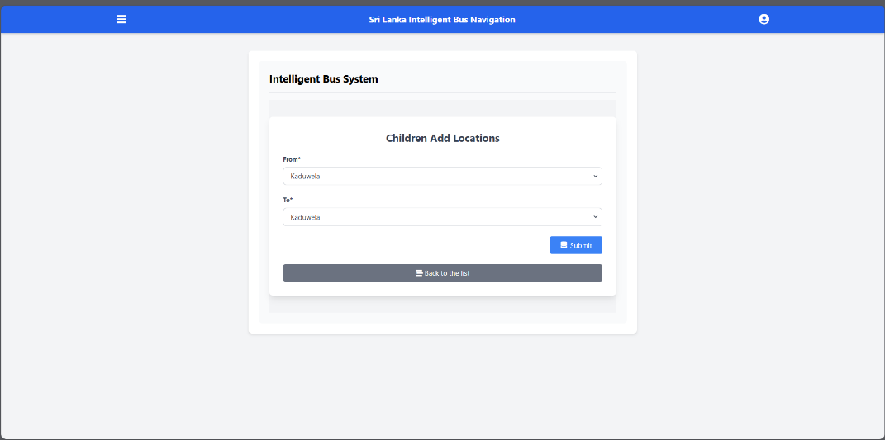

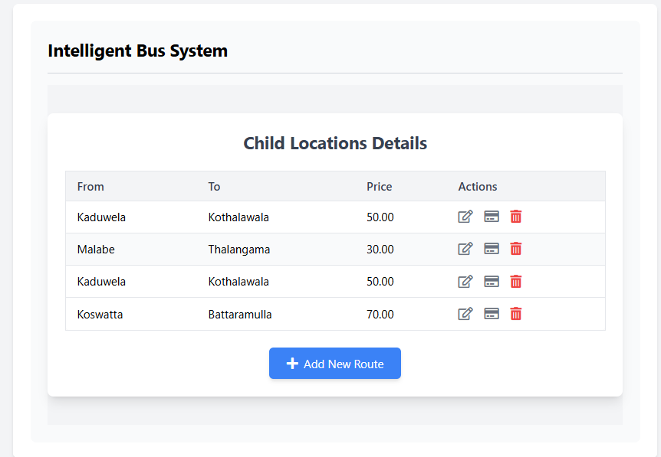
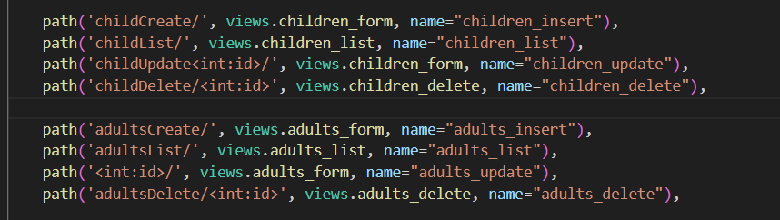
Sub Objective - 2
Passenger Categorization
Child Categorization Interface 2
Child Categorization API
Child Categorization URLs
Child Categorization Interface 2

Slide 23
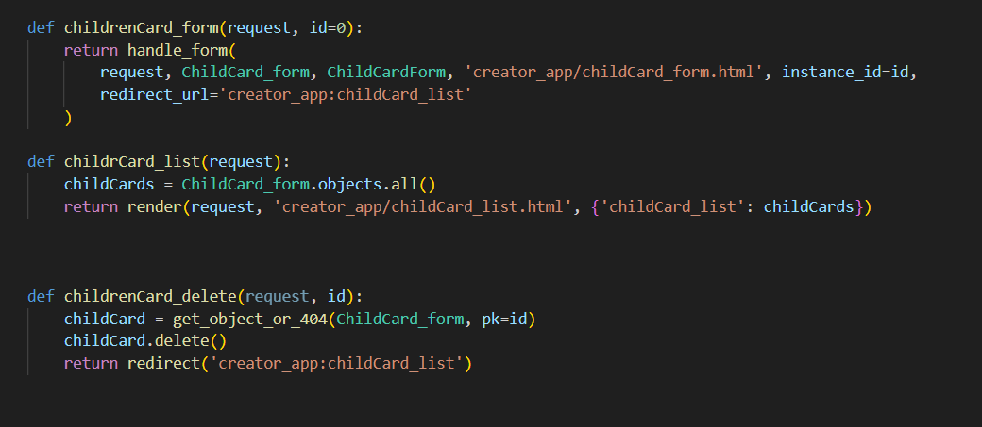
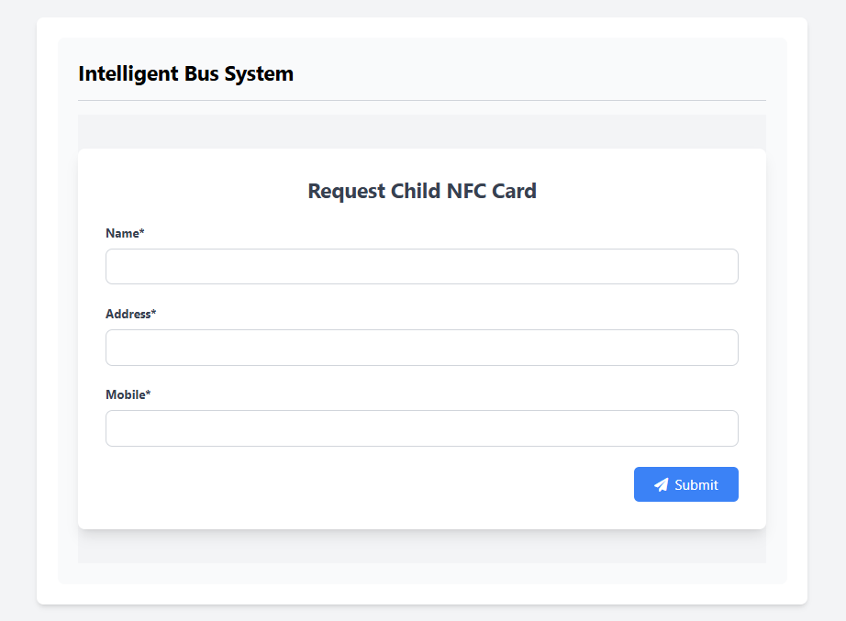
Sub Objective - 2
Requesting NFC Card
Requesting NFC Card API
Requesting NFC Card Interface

Slide 24


Sub Objective - 2
Completion of the components
Future Implementations
Authenticating Users
Enabling quick payments via NFC card taps
Categorizing Passengers
Ensuring prompt transaction communication with the conductor
Calculating cards (Route Tickets) Prices
Requesting NFC Cards

Slide 25
Gantt Chart
Milestone | Jul | Aug | Sep | Oct | Nov | Dec | Jan | Feb | Mar | Apr | May | Jun
Research about topic and tasks
Group discussion
Technology analysis
Resource evaluation
Topic Assessment Evaluation
Hardware design and implement the code
Project implementation phase 1
Integration testing
Progress Presentation 1
Project implementation phase 2
Progress presentation 2
Testing and evaluation
Final report and conclusion
IT21205460 | Senarathne A.S.C.G. | 24-25J-237

Slide 26
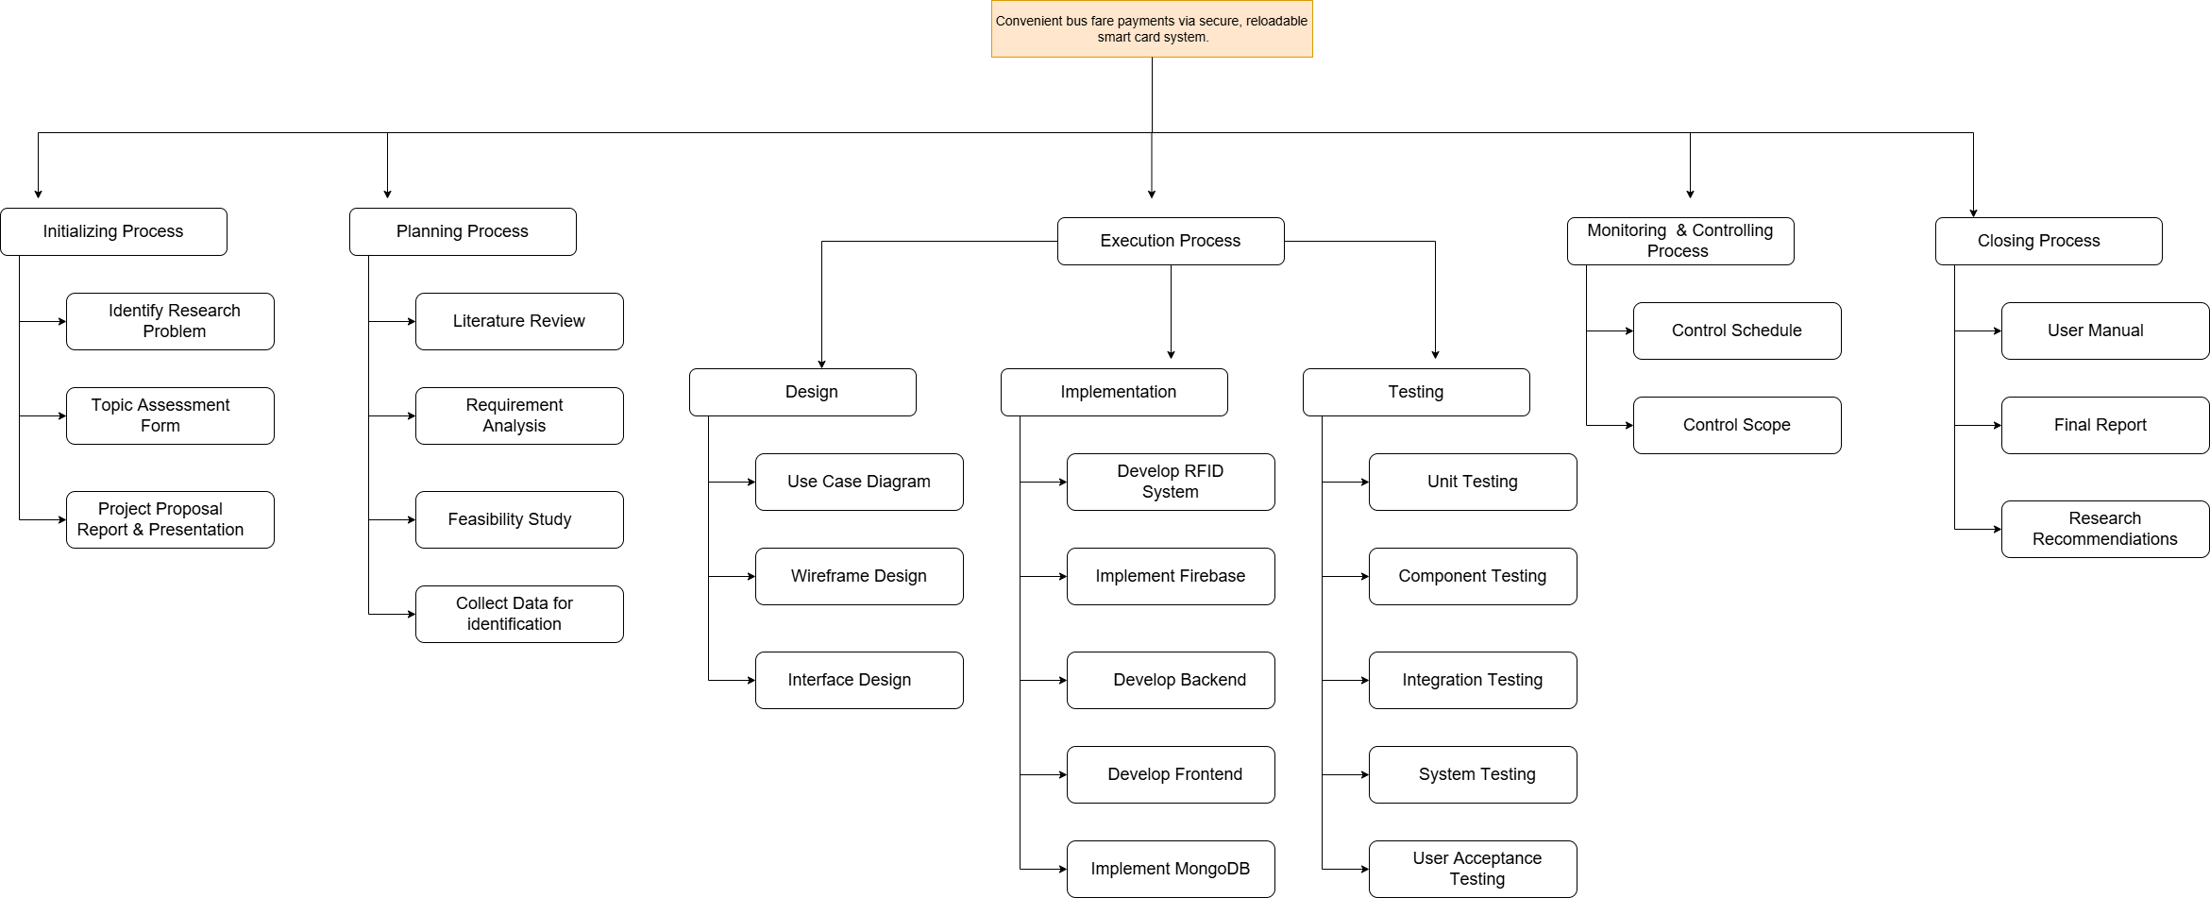
Work Breakdown Structure
NFC Development
IT21205460 | Senarathne A.S.C.G. | 24-25J-237

Slide 27
References
[1] D. Li, W. E. Wong, M. Chau, S. Pan and L. S. Koh, "A Survey ofNFC Mobile Payment: Challenges and Solutions using Blockchain and Cryptocurrencies," 2020 7th International Conference on Dependable Systems and Their Applications (DSA), Xi'an, China, 2020, pp. 69-77, doi: 10.1109/DSA51864.2020.00018. keywords: {Privacy;Protocols;Online banking;Blockchain;Bitcoin;Cryptography;Internet of Things;NFC mobile payment;blockchain;cryptocurrency;fair payment;security;privacy},
[2] H. D. Weligamage, S. M. Wijesekara, M. D. S. Chathwara, H. G. Isuru Kavinda, N. Amarasena and N. Gamage, "An Approach of Enhancing the Quality of Public Transportation Service in Sri Lanka using IoT," 2022 IEEE 13th Annual Information Technology, Electronics and Mobile Communication Conference (IEMCON), Vancouver, BC, Canada, 2022, pp. 0311-0316, doi: 10.1109/IEMCON56893.2022.9946624. keywords: {Smart cards;Visualization;Systematics;Face recognition;Sociology;Mobile communication;Real-time systems;RFID;GPS;IoT;Image Processing;Arrival time Prediction},
[3] M. Dhule, "NFC Based Smart Urban Public Bus Transport Payment System," 2018 3rd International Conference for Convergence in Technology (I2CT), Pune, India, 2018, pp. 1-4, doi: 10.1109/I2CT.2018.8529810. keywords: {Internet of Things;Radiofrequency identification;Intelligent sensors;Global Positioning System;Sociology;Statistics;Transportation;Public Bus;E-ticketing;NFC;Mobile App;Cheat-Proof},
[4] S. A. Jayalath, C. Rajapakse and J. M. D. Senanayake, "A microtransaction model based on blockchain technology to improve service levels in public transport sector in Sri Lanka," 2020 International Research Conference on Smart Computing and Systems Engineering (SCSE), Colombo, Sri Lanka, 2020, pp. 82-89, doi: 10.1109/SCSE49731.2020.9313037. keywords: {Blockchain;Public transportation;Smart contracts;Rail transportation;Peer-to-peer computing;Companies;Prototypes;Consortium blockchains;Ethereum;Micro-payments;Smart contracts;Transportation},
IT21205460 | Senarathne A.S.C.G. | 24-25J-237

Slide 28
IT21202490 |Kalhara N.V.
BSc (Hons) Degree in Information Technology ( specialization in Information Technology )
ITXXXXXXXX | <<Student Name>> | <<Project ID>>

Slide 29

BACKGROUND
Collect vehicle location and speed data from Firebase.
Use machine learning on historical and traffic data to estimate arrival times.
Show real-time tracking and ETAs in a user-friendly app.
Include voice commands and sound feedback for visually impaired users.
Develop a chatbot to provide quick access to bus routes, schedules, and ETAs, enhancing user convenience and satisfaction.
IT21202490 | Kalhara N.V. | 24-25J-237

Slide 30
Accuracy of ETA Predictions:
Existing systems often struggle with accuracy and do not effectively integrate real-time traffic conditions and historical data, leading to less reliable ETAs under varying conditions and unforeseen events.
Accessibility Features:
Current systems often lack features tailored for visually impaired users, such as voice commands and sound feedback.
Information Retrieval
Existing solutions do not offer integrated chatbots for easy access to route information and schedules, requiring users to manually navigate apps.
Comparison Chart
 | Research paper 1 [1] | Research paper 2 [2] | Research paper 3 [3] | Research paper 4 [4] | Our System
ETA prediction with current traffic conditions
ETA prediction with historical data
Details via a mobile application
Voice enhanced features focusing on visually impaired users
Chatbot for route information
IT21202490 | Kalhara N.V. | 24-25J-237

Slide 31
How can a real-time vehicle tracking and ETA prediction system, enhanced with machine learning, a voice-enabled system for visually impaired users, and a chatbot for quick information retrieval, improve the accuracy of public transportation management and user experience?
IT21202490 | Kalhara N.V. | 24-25J-237

Slide 32
Specific Objective and Sub Objectives
Real-Time Vehicle Tracking
ETA Estimation Using Machine Learning
Develop an intelligent transportation tracking system that provides real-time vehicle tracking, estimated arrival times, and accessibility features to enhance user convenience and satisfaction.
User-Friendly Interface
Accessibility Features for visually impaired users
Chatbot Integration
IT21202490 | Kalhara N.V. | 24-25J-237

Slide 33
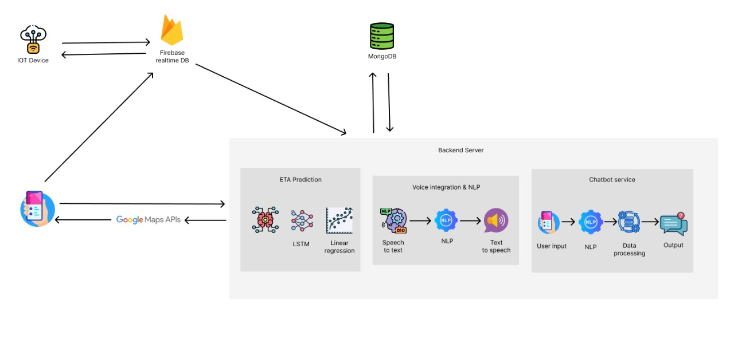
IT21202490 | Kalhara N.V. | 24-25J-237

Slide 34
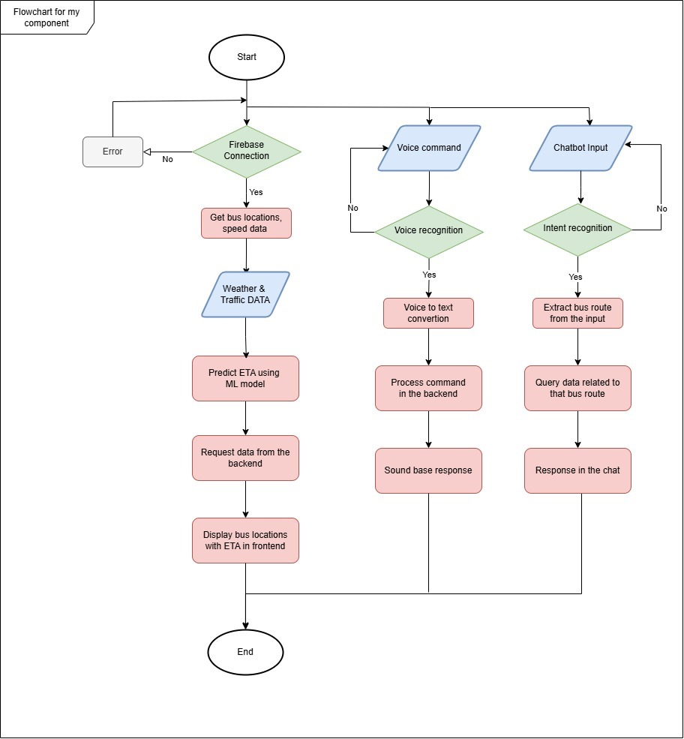
Flow Chart
IT21202490 | Kalhara N.V. | 24-25J-237

Slide 35
Technologies to be used
Techniques
Data preprocessing
Feature Engineering
Cross validation
Hyperparameter tuning
Technologies
Django
React Native
Firebase
Google Colab
Google Maps
Open weather
RASA
Algorithms
Random Forest Regressor
Gradient Boost
Linear Regression
IT21202490 | Kalhara N.V. | 24-25J-237

Slide 36
PROJECT REQUIREMENTS
Functional Requirements
ETA Prediction
Data Collection and Transmission
User Interface
Voice and sound integration
Firebase Integration
.
Non-Functional Requirements
Performance
Security
Compatibility
Adaptability
IT21202490 | Kalhara N.V. | 24-25J-237

Slide 37
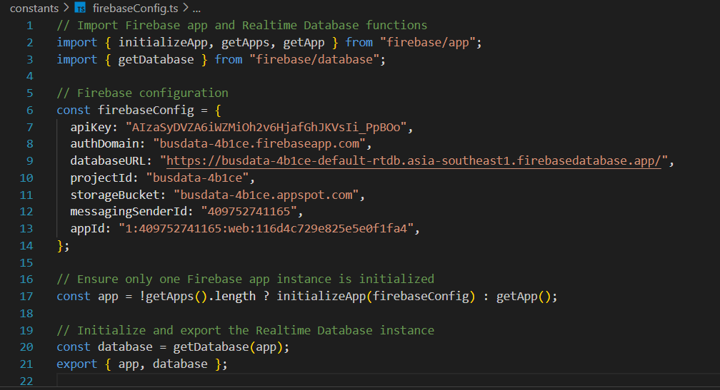
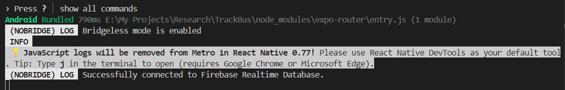
RandomForestRegressor
Evidences for Completion
Firebase configuration file
IT21202490 | Kalhara N.V. | 24-25J-237

Slide 38
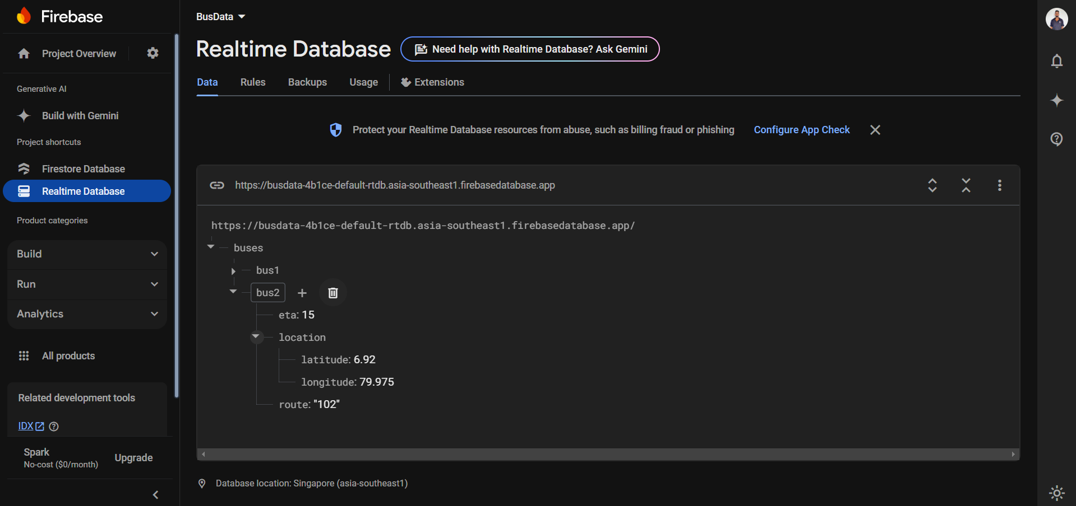
RandomForestRegressor
Evidences for Completion
Bus data in firebase
IT21202490 | Kalhara N.V. | 24-25J-237

Slide 39
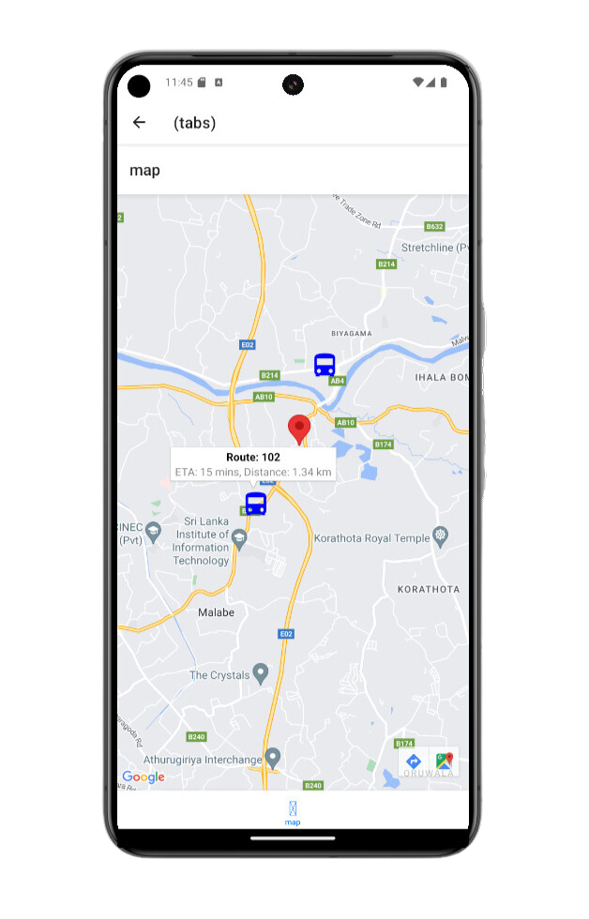
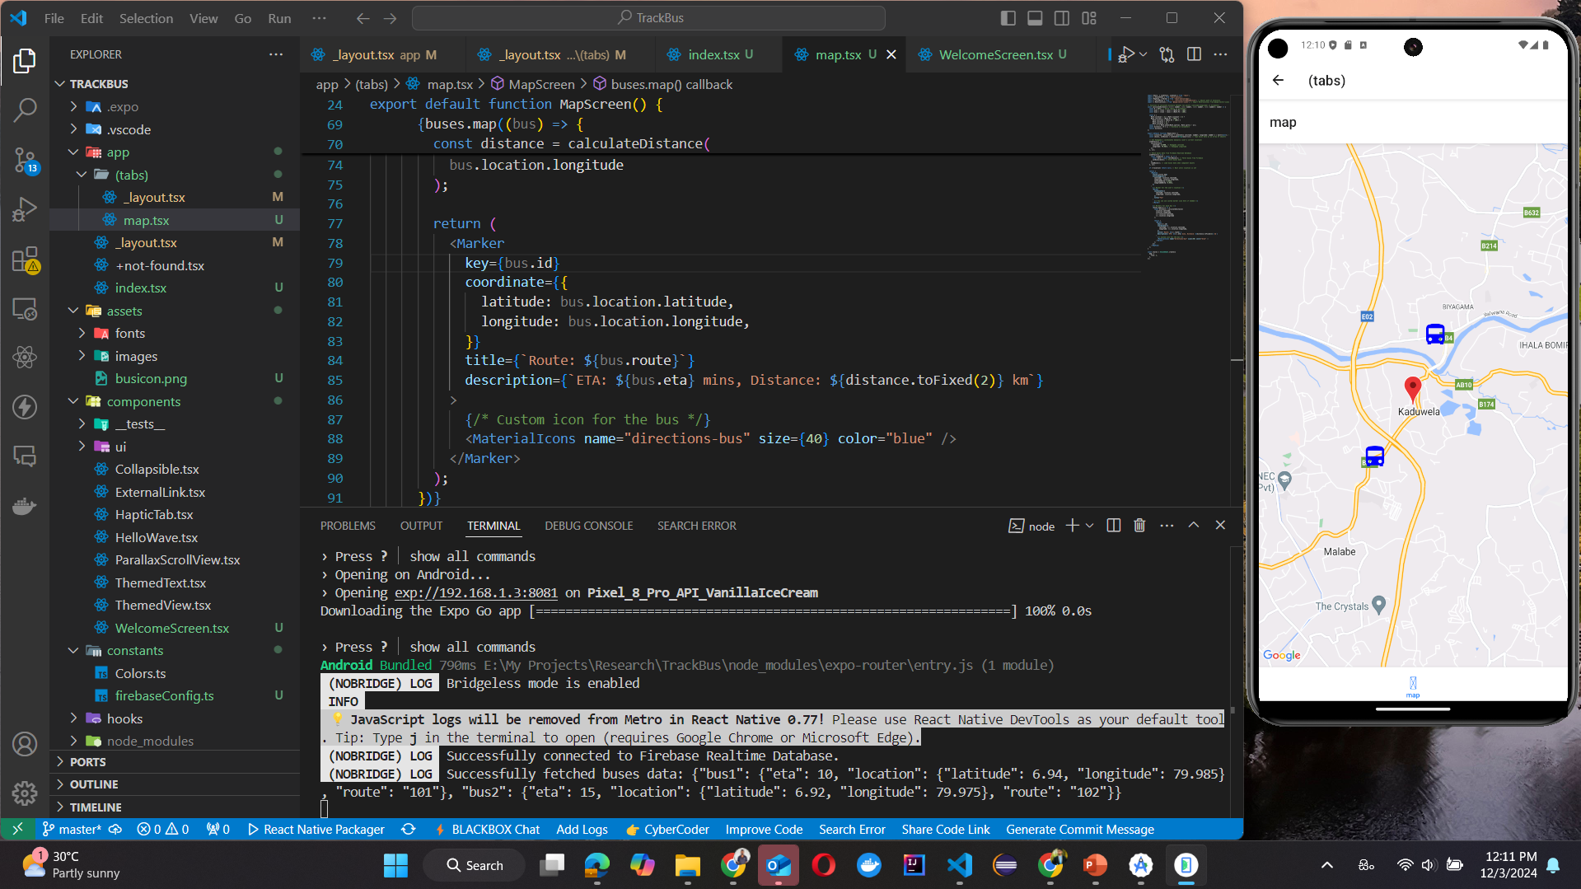
RandomForestRegressor
Evidences for Completion
Bus data showing in the frontend
IT21202490 | Kalhara N.V. | 24-25J-237

Slide 40
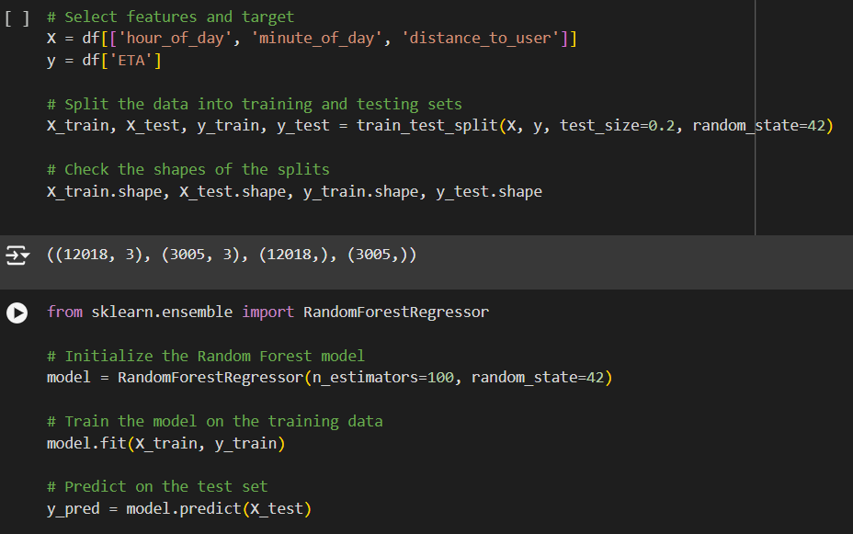
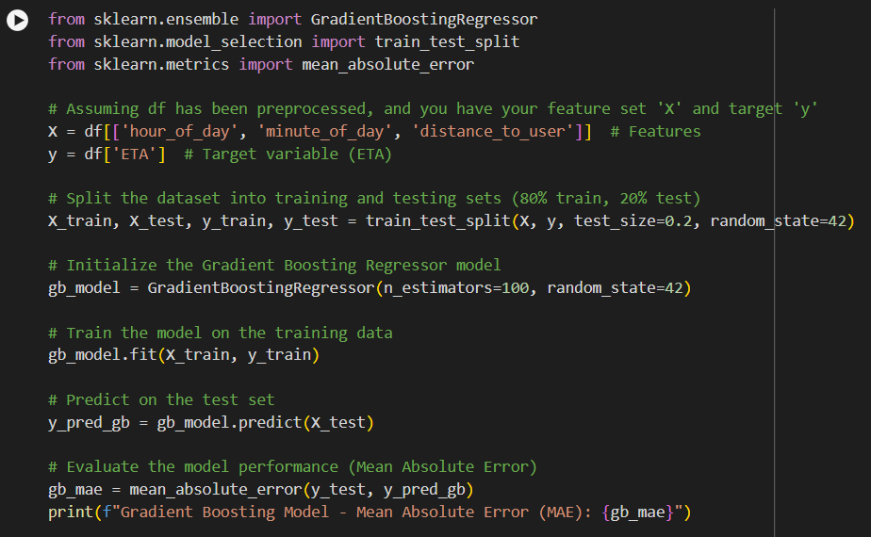
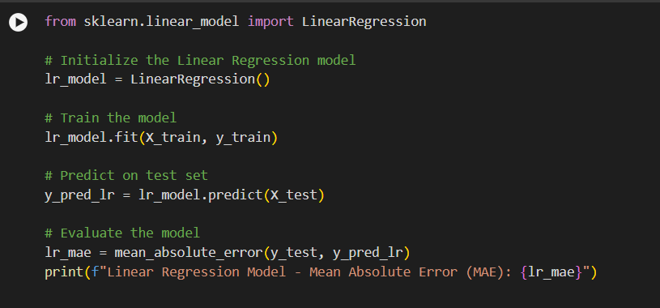
RandomForestRegressor
Evidences for Completion
ML model implementations
IT21202490 | Kalhara N.V. | 24-25J-237

Slide 41
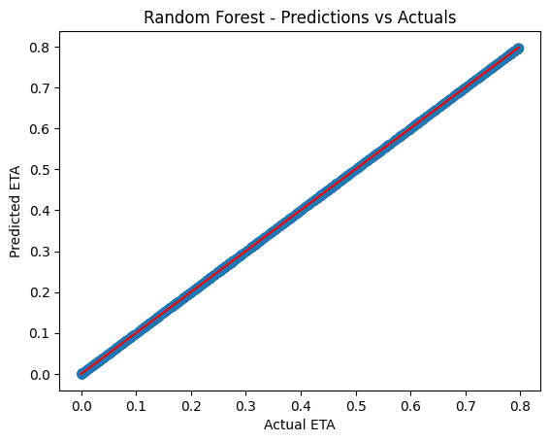
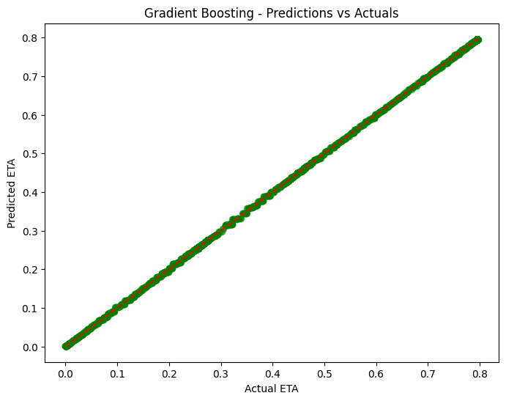
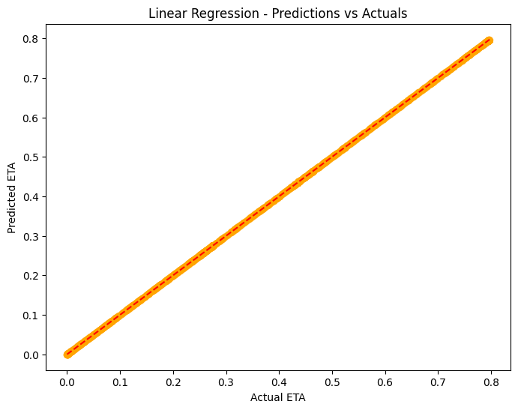
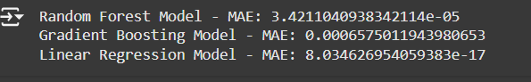
RandomForestRegressor
Evidences for Completion
Comparison of the models
IT21202490 | Kalhara N.V. | 24-25J-237

Slide 42
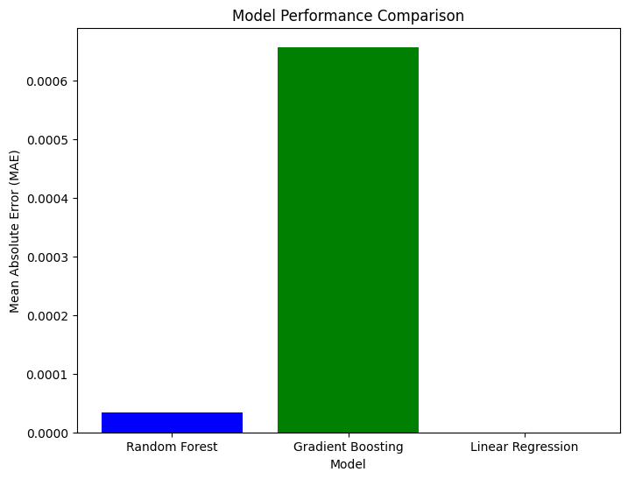
RandomForestRegressor
Evidences for Completion
Comparison of the models
 | MAE | Remarks
GB | 0.00066 | Slightly higher error than Random Forest but still very good.
RF | 3.42e-05 | Excellent performance with very low error.
LR | 8.03e-17 | Extremely low error, but the model may be too simplistic.
IT21202490 | Kalhara N.V. | 24-25J-237

Slide 43
Gantt Chart
Milestone | Jul | Aug | Sep | Oct | Nov | Dec | Jan | Feb | Mar | Apr | May | Jun
Research about topic and tasks
Group discussion
Technology analysis
Resource evaluation
Topic Assessment Evaluation
Hardware design and implement the code
Project implementation phase 1
Integration testing
Progress Presentation 1
Project implementation phase 2
Progress presentation 2
Testing and evaluation
Final report and conclusion
IT21202490 | Kalhara N.V. | 24-25J-237

Slide 44
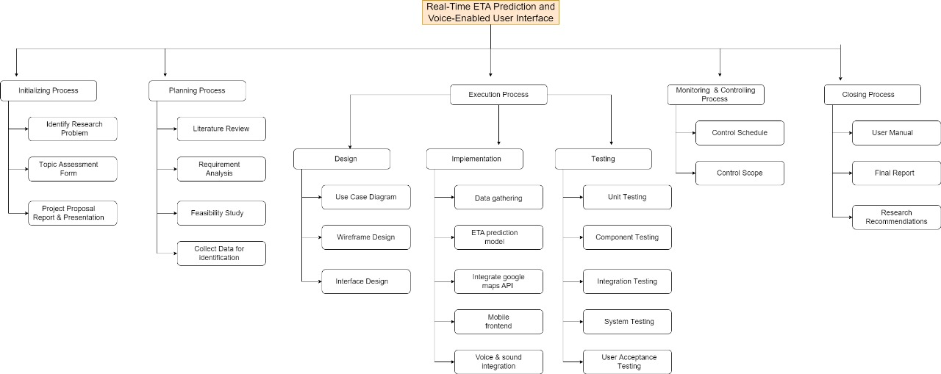
Work Breakdown Structure
IT21202490 | Kalhara N.V. | 24-25J-237

Slide 45
References
[1]
H. D. Weligamage, S. M. Wijesekara, M. D. S. Chathwara, H. G. Isuru Kavinda, N. Amarasena and N. Gamage, "An Approach of Enhancing the Quality of Public Transportation Service in Sri Lanka using IoT," 2022 IEEE 13th Annual Information Technology, Electronics and Mobile Communication Conference (IEMCON), Vancouver, BC, Canada, 2022, pp. 0311-0316, doi: 10.1109/IEMCON56893.2022.9946624. keywords: {Smart cards;Visualization;Systematics;Face recognition;Sociology;Mobile communication;Real-time systems;RFID;GPS;IoT;Image Processing;Arrival time Prediction},
[2]
R. C. Jisha, A. Jyothindranath and L. S. Kumary, "Iot based school bus tracking and arrival time prediction," 2017 International Conference on Advances in Computing, Communications and Informatics (ICACCI), Udupi, India, 2017, pp. 509-514, doi: 10.1109/ICACCI.2017.8125890. keywords: {Global Positioning System;Radiofrequency identification;Microcontrollers;Receivers;Hardware;Real-time systems;Modems;Vehicle tracking;microcontroller;RFID;GPS;GSM/GPRS;Arduino;Android;Cloud;Kalman filtering},
[3]
A. C. M. Nafrees, S. M. S. Raseez, C. G. Ubeshanan, K. Achutharaj and A. L. Hanees, "Intelligent Transportation System using Smartphone," 2021 5th International Conference on Electrical, Electronics, Communication, Computer Technologies and Optimization Techniques (ICEECCOT), Mysuru, India, 2021, pp. 229-234, doi: 10.1109/ICEECCOT52851.2021.9708053. keywords: {Costs;Pandemics;Human factors;Cameras;Real-time systems;Social factors;Public transportation;Intelligent Transportation System;Vehicle Tracking;GPS;Cloud Computing;Real-time;Mobile Application},
[4]
S. Vaishnavi, G. Renish, T. Surendra, J. R. Kumar and V. Srinivasan, "Advancements in Public Transport: Design and Implementation of an Android-Based Real-Time Bus Tracking System," 2023 IEEE 5th International Conference on Cybernetics, Cognition and Machine Learning Applications (ICCCMLA), Hamburg, Germany, 2023, pp. 41-46, doi: 10.1109/ICCCMLA58983.2023.10346218. keywords: {Schedules;Costs;Web services;Smart cities;Urban areas;Real-time systems;Timing;Smart Bus;Digital Technology;Google Maps API;Smart Cities},
IT21202490 | Kalhara N.V. | 24-25J-237

Slide 46
IT21175848 |Thanusan M.
BSc (Hons) Degree in Information Technology ( specialization in Information Technology )

Slide 47
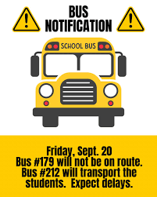
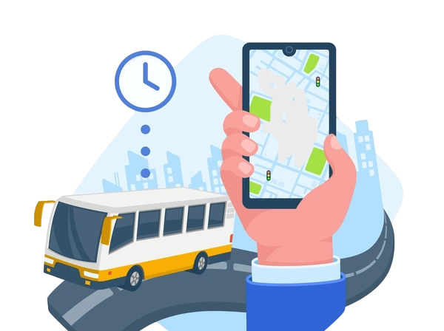
BACKGROUND
User Login and Travel Information System
– Allows users to select travel details and provides
bus routes with relevant information.
Seat Availability Detection – Uses computer
vision to identify available seats in real time.
Personalized Bus Recommendations – Trains a model on user routines to recommend buses and notify users about seat availability and bus arrival times.
IT21175848 | Thanusan M. | 24-25J-237

Slide 48


How can user behavior and travel preferences be effectively utilized to provide personalized bus recommendations and improve the public transportation experience?
How can computer vision techniques be implemented to accurately detect seat availability in real time and integrate this data into a comprehensive bus tracking system?
IT21175848 | Thanusan M. | 24-25J-237

Slide 49
Specific Objective and Sub Objectives
Personalized Bus Recommendation
Implementing blockchain for secure, transparent transactions.
Enhancing Travel Experience for Locals and Tourists with a Smart Bus System and Personalized Recommendations.
Real-Time Seat Availability Detection Using Computer Vision
User Login and Personalized Travel Information System
Arrival time notification.& Enhance tourist experience.
IT21175848 | Thanusan M. | 24-25J-237

Slide 50
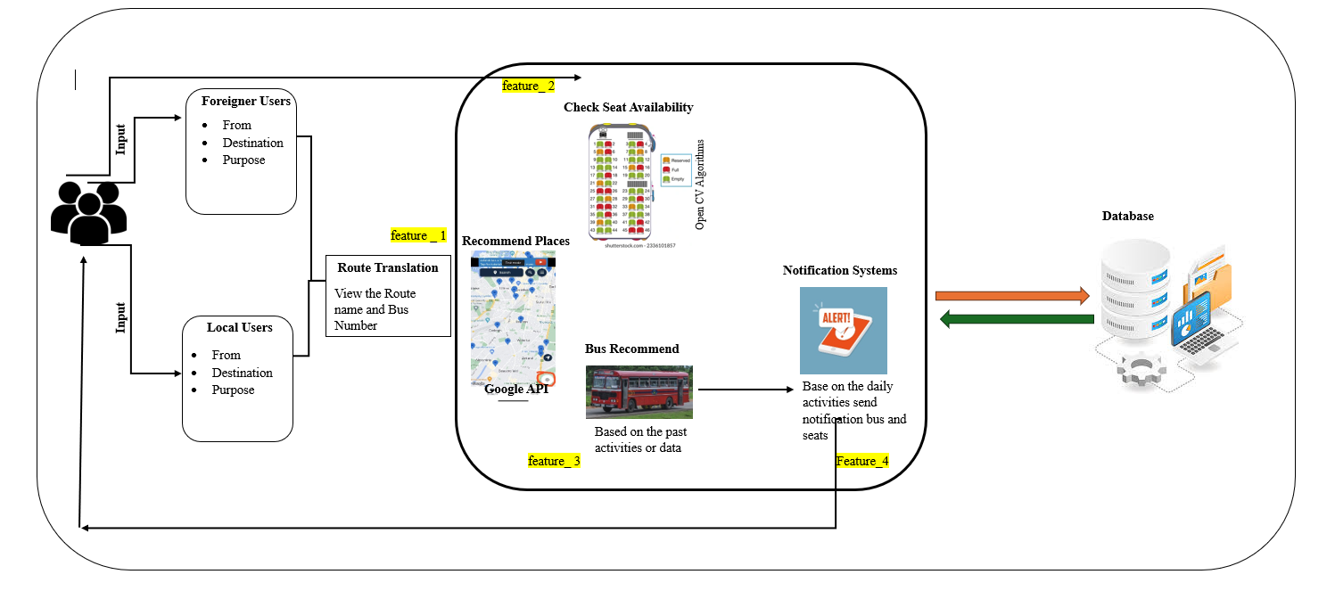
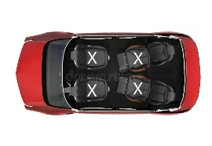
IT21175848 | Thanusan M. | 24-25J-237

Slide 51
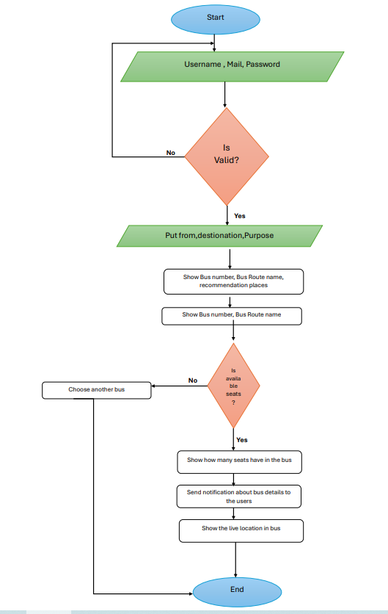
Flow Chart

Slide 52

Technologies to be used
Algorithms
Techniques
Data Augmentation
Cross-Validation
Feature Engineering
Hyperparameter Tuning
Transfer Learning
Technologies
React Native
Bootstrap
Google Maps API
Firebase Cloud Messaging (FCM)
Node.js
Python (Django)
OpenCV
GPS APIs
Serper.dev
Time Series
Algorithms and
Architecture
OpenCV Algorithms
Authentication Algorithms
IT21175848 | Thanusan M. | 24-25J-237

Slide 53
PROJECT REQUIREMENTS
Functional Requirements
Secure user login and profile management.
Allow users to select travel preferences (origin, destination, purpose).
Provide bus route details (route number, license plate).
Real-time seat detection using computer vision.
Track buses in real time using GPS.
Recommend buses based on user behavior.
Send notifications about bus arrival and seat availability.
Display routes and nearby places on an interactive map.
Collect and analyze user data for system improvement.
Non-Functional Requirements
Performance
Scalability
Security
Reliability
Usability
IT21175848 | Thanusan M. | 24-25J-237

Slide 54



Completion & Future work
Completion
User Authentication ( Local and foreigner )
Places recconmend
Seat availability
Future Work
Seat availability enhance
User behaviral model train
Ovral mobile application

Slide 55
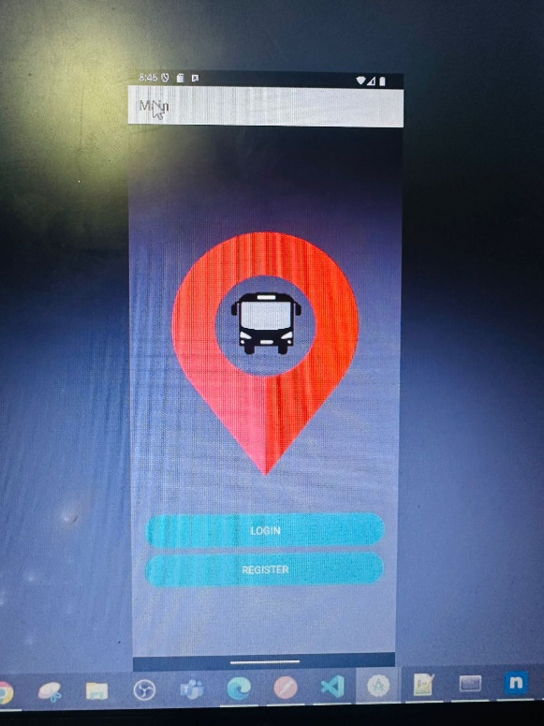
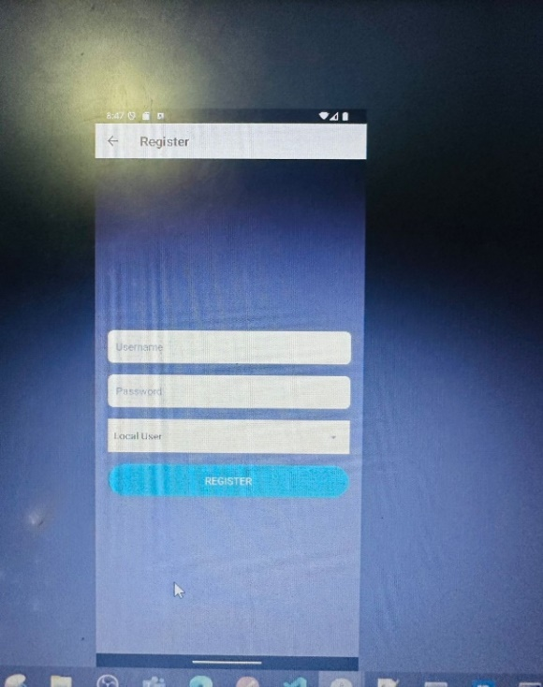
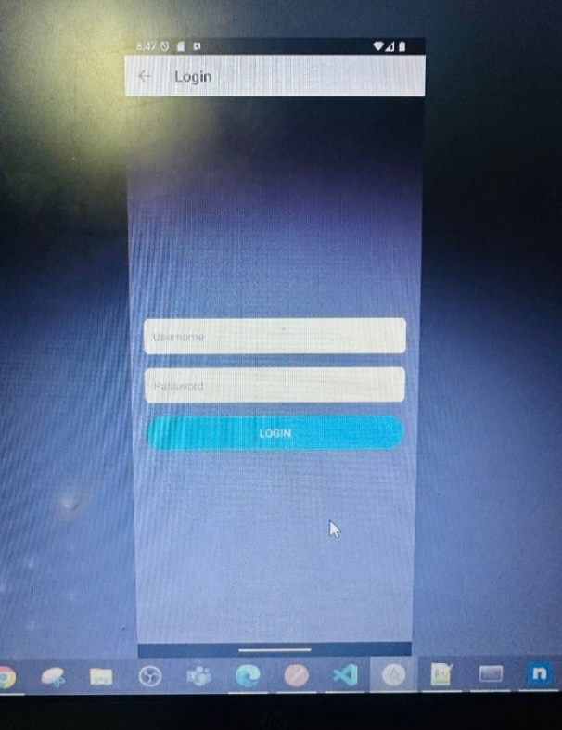

Evidence Of Completion
Frontend Development

Slide 56

The script identifies specific patterns defined by template images within a larger image, counts the detected patterns, and highlights them using rectangles.

Slide 57




This code is a REST API application designed to interact with a MySQL database. Below is an explanation of the functionality and the purpose of each endpoint

Slide 58




`Dashboard
`Login

Slide 59




Route Screen

Slide 60



API Run Postman Check for Route Recommendation

Slide 61
Gantt Chart
Milestone | Jul | Aug | Sep | Oct | Nov | Dec | Jan | Feb | Mar | Apr | May | Jun
Research about topic and tasks
Group discussion
Technology analysis
Resource evaluation
Topic Assessment Evaluation
Hardware design and implement the code
Project implementation phase 1
Integration testing
Progress Presentation 1
Project implementation phase 2
Progress presentation 2
Testing and evaluation
Final report and conclusion
IT21175848 | Thanusan M. | 24-25J-237

Slide 62

Work Breakdown Structure
IT21175848 | Thanusan M. | 24-25J-237

Slide 63
References
[1] "GSM and GPS-Based Vehicle Tracking System," Electronics For You, Accessed: Aug. 12, 2024. [Online]. Available: https://www.electronicsforu.com/electronics-projects/hardware-diy/gsm-gps-based-vehicle-tracking-system
[2] V. Kumar, "Vehicle Number Plate Detection System Using Image Processing Approach," ResearchGate, Accessed: Aug. 12, 2024. [Online]. Available: https://www.researchgate.net/publication/375883893_Vehicle_Number_Plate_Detection_System_Using_Image_Processing_Approach#:~:text=The%20number%20plate%20region%20in,contains%20the%20specific%20vehicle%20information
[3]S. Du, M. Ibrahim, M. Shehata, and W. Badawy, "Automatic license plate recognition (ALPR): A state-of-the-art review," in IEEE Transactions on Circuits and Systems for Video Technology, vol. 23, no. 2, pp. 311-325, Feb. 2013, doi: 10.1109/TCSVT.2012.2203741. [Online]. Available: https://ieeexplore.ieee.org/document/6143420
[4]"Places API Overview," Google Maps Documentation, Accessed: Aug. 12, 2024. [Online]. Available: https://developers.google.com/maps/documentation/places/web-service/overview
[5]"Notifications: Track Your Vehicle with Ease," GPS-Trace Blog, Accessed: Aug. 12, 2024. [Online]. Available: https://gps-trace.com/en/blog/notifications-track-your-vehicle-with-ease#:~:text=Geofence%20alerts%20allow%20you%20to,of%20or%20into%20those%20boundaries.&text=They%20make%20it%20clear%20if,with%20which%20it%20is%20used.&text=Trip%20notifications%20can%20be%20used,start%2Fend%20of%20a%20trip
IT21175848 | Thanusan M. | 24-25J-237

Slide 64
IT21192050 |Rajapaksha R.L.H.P.
BSc (Hons) Degree in Information Technology ( specialization in Information Technology )
IT21192050 | Rajapaksha R.L.H.P | 24-25J-237

Slide 65

BACKGROUND
Due to competition among buses, terrible accidents occur.
A 2022 survey in Sri Lanka on bus accidents shows
Fatal accidents involving private buses: 172 [1]
Fatal accidents involving SLTB buses: 63 [1]
Passengers' ability to reach their destination comfortably.
When public transport is not comfortable, many people prefer to travel by their own vehicles.
Avoid missing the waiting bus.
When a waiting bus is missed, the passenger's time is wasted.
IT21192050 | Rajapaksha R.L.H.P | 24-25J-237

Slide 66
Comparison Chart
Research A - IoT-based bus monitoring system using a mobile app for real-time tracking of bus location, seat availability, and passenger activities, enhancing service efficiency and management.
Research B - IoT-based system improves Sri Lanka's public transport with real-time bus tracking, automated ticketing, and smart card authentication for enhanced service efficiency.
Research C- IoT-based GPS vehicle tracking and theft detection system using Google Cloud IoT Core and Firebase for real-time location monitoring and theft alerts via a web interface.
Application Reference | Displaying the distance between a bus and the bus in front of it. | Displaying the passengers boarding from the next stop. | Passengers can get an idea about the seat availability of the bus. | Use MQTT for pass the data | Connect the IoT device to the internet using a GSM/GPRS module.
Research A
Research B
Research C
Proposed System
IT21192050 | Rajapaksha R.L.H.P | 24-25J-237

Slide 67

How can the driver be informed about the number of passengers waiting to board at the next bus stop?
How can we provide a comfortable environment for passengers to reach their destination?
How can we reduce competition between buses and minimize collisions and road accidents?
IT21192050 | Rajapaksha R.L.H.P | 24-25J-237

Slide 68
Specific Objective and Sub Objectives
Facilitate Real-Time Data Sharing
Enhance Driver Awareness
Enhance passenger comfort and safety by optimizing bus operations using real-time IoT
Reduce Bus Competition
Monitor Seat Availability
Ensure Reliable Connectivity
IT21192050 | Rajapaksha R.L.H.P | 24-25J-237

Slide 69

IT21192050 | Rajapaksha R.L.H.P | 24-25J-237

Slide 70

Flow Chart

Slide 71

Technologies to be used
Technologies
Esp 32
MQTT
Firebase Realtime Database
C++
AWS
IT21192050 | Rajapaksha R.L.H.P | 24-25J-237

Slide 72
PROJECT REQUIREMENTS
Software Requirements
VS Code
Arduino IDE
Hardware Requirements
Breadboard
Connecting wires
Esp 32 Board
Esp 32 Cam Module
GSM/GPRS Module
GPS Module
LCD Display
Functional Requirements
System should be able to stable internet connection.
System should be able to Data Acquisition
System should be able to Cloud Storage integration.
System should be able to Real-Time Location Tracking.
Non-Functional Requirements
System should be Real-Time Processing
System should be Data Transmission Reliability
Always System should be Availability
System should be Data Integrity
IT21192050 | Rajapaksha R.L.H.P | 24-25J-237

Slide 73







Completed objectives
Methodology
Evidence of completion
Sub - Objective 1
Deploy the backend Server and connect it to the database
Sub - Objective 2
Track real-time data using a GPS module.
Display database data on an LCD Display
Sub - Objective 3
Establish a reliable internet connection on the ESP32 Board

Slide 74


Sub Objective 1
Server connection and data updating part

Slide 75


Data get on Server

Slide 76



Deployed Server
Server code snip
Deploy on AWS with EC2 instance

Slide 77



Sub Objective 2
Create pin connection of board
Create internet setting

Slide 78


Sub Objective 3
Show response data on an LCD Display

Slide 79

Completion And Future Works
Completion of the components
Future Implementations
Reliable Connection
Create Data passing through MQTT protocol
Realtime data send to the Server
Add camera module and send data to Server
Database data show on an Display
Get distance on two buses and send it to the database
45%
55%

Slide 80
Gantt Chart
Milestone | Jul | Aug | Sep | Oct | Nov | Dec | Jan | Feb | Mar | Apr | May | Jun
Research about topic and tasks
Group discussion
Technology analysis
Resource evaluation
Topic Assessment Evaluation
Hardware design and implement the code
Project implementation phase 1
Integration testing
Progress Presentation 1
Project implementation phase 2
Progress presentation 2
Testing and evaluation
Final report and conclusion
IT21192050 | Rajapaksha R.L.H.P | 24-25J-237

Slide 81

Work Breakdown Structure
IT21192050 | Rajapaksha R.L.H.P | 24-25J-237

Slide 82
References
[1 ] Randula (no date) Home, MINISTRY OF TRANSPORT AND HIGHWAYS. Available at: https://www.transport.gov.lk/web/index.php?option=com_content&view=article&id=29&Itemid=149&lang=en#type-of-vehicles-involved-in-accidents.
[2] M. F. M. A. Hakeem, N. A. Sulaiman, M. Kassim and N. M. Isa, "IoT Bus Monitoring System via Mobile Application," 2022 IEEE International Conference on Automatic Control and Intelligent Systems (I2CACIS), Shah Alam, Malaysia, 2022, pp. 125-130, doi: 10.1109/I2CACIS54679.2022.9815268. keywords: {Schedules;Databases;Urban areas;Prototypes;Mobile applications;Internet of Things;Monitoring;Bus Monitoring System;IoT;GPS;mobile apps;Wi-Fi},
[3] H. D. Weligamage, S. M. Wijesekara, M. D. S. Chathwara, H. G. Isuru Kavinda, N. Amarasena and N. Gamage, "An Approach of Enhancing the Quality of Public Transportation Service in Sri Lanka using IoT," 2022 IEEE 13th Annual Information Technology, Electronics and Mobile Communication Conference (IEMCON), Vancouver, BC, Canada, 2022, pp. 0311-0316, doi: 10.1109/IEMCON56893.2022.9946624. keywords: {Smart cards;Visualization;Systematics;Face recognition;Sociology;Mobile communication;Real-time systems;RFID;GPS;IoT;Image Processing;Arrival time Prediction},
[4] P. V. Crisgar, P. R. Wijaya, M. D. F. Pakpahan, E. Y. Syamsuddin and M. O. Hasanuddin, "GPS-Based Vehicle Tracking and Theft Detection Systems using Google Cloud IoT Core & Firebase," 2021 International Symposium on Electronics and Smart Devices (ISESD), Bandung, Indonesia, 2021, pp. 1-6, doi: 10.1109/ISESD53023.2021.9501928. keywords: {Cloud computing;Tracking;User interfaces;Internet;Automobiles;Telemetry;Smart devices;Internet of Things;Vehicle Tracking System;Theft Detection;Google Cloud IoT Core;Firebase},
IT21192050 | Rajapaksha R.L.H.P | 24-25J-237

